Slide 1
PHP Fundamentals
W/ Rene Torres

Slide 2
INTRODUCTION TO PHP What is PHP
PHP is scripting language
PHP is an acronym for Hypertext Preprocessor
Scripting Language that is interpreted on a server
Used for Web Development
Create, Read, Delete, and Write to files
Used for accessing Data Bases ie. MySql, Sql , Mongo db, ect.
Creates Dynamic Websites
Language used in most Content Management Systems (ie. Joomla, Wordpress , Drupal, Mambo, Magneto, Moodle,ect.)

Slide 3
What do I need to use PHP
Text Editor ( Notepad ++, Dreamweaver , Aptana Studio , Sublime Text)
We will be using Notepad ++ in this course, but you are more than welcome to use any text editor that you like( just as long as you understand how it works )
Server (WAMP , MAMP ,XAMP,AMMPS,UNIFORM,SECURE WAMP,)
We will be using Wamp in this course, but you are more than welcome to use any server software that you would like(just as long as you understand how it works )

Slide 4

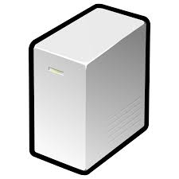
How does it work
Request
Web Server interprets PHP Request
Reply in Html

